Slide 1




San Ramon Valley USD Retiree Healthcare Informational Meeting
The Hartford Medicare Supplement and Express Scripts Part D
November 6th 2025

Slide 2
Agenda and Housekeeping
A recording of todays presentation will be made available to retirees upon request. All participants are muted.
We will answer all questions at the end of today’s presentation.
Please type any questions in the chat.
Or text questions to 248-701-9218 or email questions to DaynaZaks@hismi.com throughout today’s presentation.
Questions which are texted or emailed during the meeting will be answered during the Q&A portion.
For personal questions please contact Benistar Administrative Services at 1-800-236-4782.

Slide 3
Agenda and Housekeeping
Your Retiree Healthcare Team
Retiree Service Center at Benistar
Plan Details Anthem
Plan Details Express Scripts
FAQs
Open Q&A
Medicare 101 Overview
Next Steps and Enrollment

Slide 4

Your Retiree Healthcare Team
The Hartford Medicare Supplement
Express Scripts Part D
Benistar Administrative Services

Slide 5
How Benistar Can Help You
Enrollment & Eligibility Support | Lower-Cost Generic Options | Provider Network Questions
Copay Assistance Support | Prior Authorization/ Pre-Certifications | Billing Questions
Plan Design Questions | Pharmacy locater | Formulary Questions
Benistar Retiree Service Center 1-800-236-4782

Slide 6
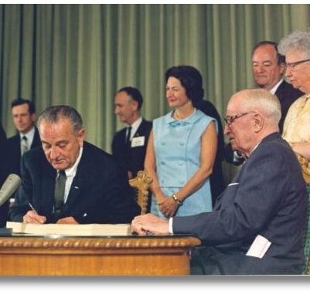
Medicare Parts
Medicare Part A – Hospitalizations.
Medicare Part B – Outpatient Services.
Medicare Part C – Medicare Advantage.
Medicare Part D – Prescription Drugs.

Slide 7

What is Medicare Secondary Plan?
Medicare Secondary Plans are Benefit Plans that help pay some of the health care costs that Original Medicare doesn't cover, such as cost-sharing gaps within Medicare Parts A and B(copayments, coinsurance and deductibles).
A Medicare Secondary plan pays after Medicare pays their portion. Medicare is Primary and the Secondary Plan is Secondary. Typically, Medicare pays 80% and the plan pays 20%.
No Networks: Plan offers the freedom to choose any doctor, specialist, facility and hospital that accepts Medicare Assignment
Full Guarantee Issue – No medical questions
Portable Coverage – Nationwide coverage is available in all 50states

Slide 8

2026 Group Retiree Benefits - Eligibility
Retiree/Spouse must be age 65 or older.
Must be enrolled in Medicare Part A and Medicare Part B.
Medical and Prescription Coverage are a Bundled Benefit.
When you are enrolled in the “Group” Medicare plan, you cannot elect an individual plan.
The Express Scripts Prescription Plan is a Credible Medicare Part D Plan. You do not need to sign up for another Part D Plan.
You can only have one Part D plan. If you sign up for another Part D plan, this plan will be terminated.
Dependents that are not Medicare eligible will remain on their current coverage plan.

Slide 9
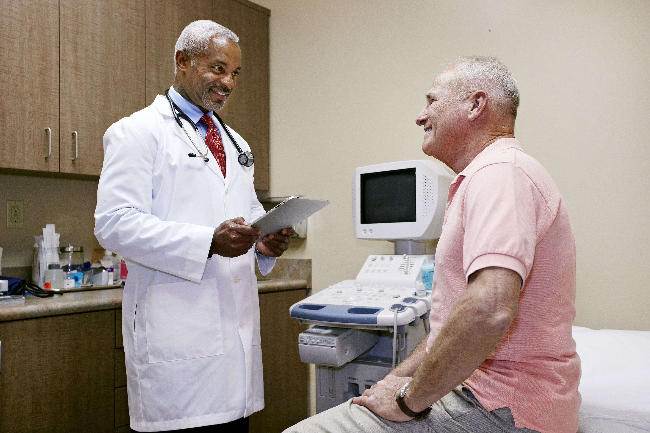
2026 Group Retiree Medical Benefit Highlights
The Hartford plan follows Medicare and has no network as long as the provider or facility accepts Medicare.
You can see any doctor who accepts Medicare:
No provider Network
No prior approval for services
No referrals are required
Nationwide coverage

Slide 10
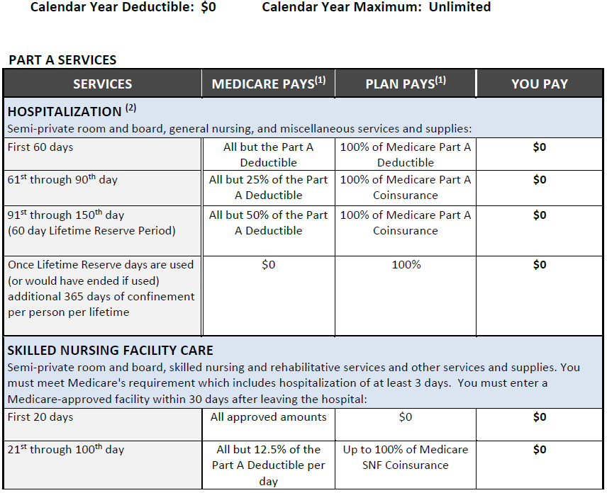
Medical Benefits

Slide 11
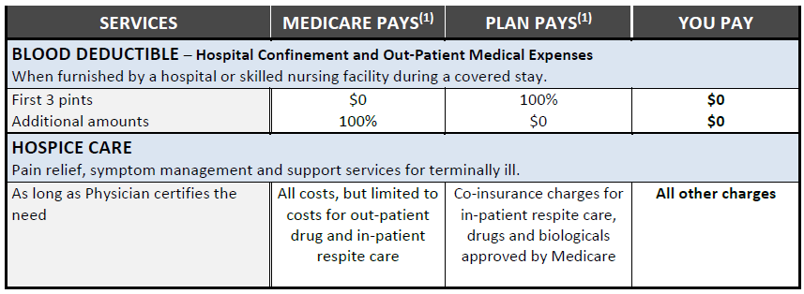
Medical Benefits

Slide 12
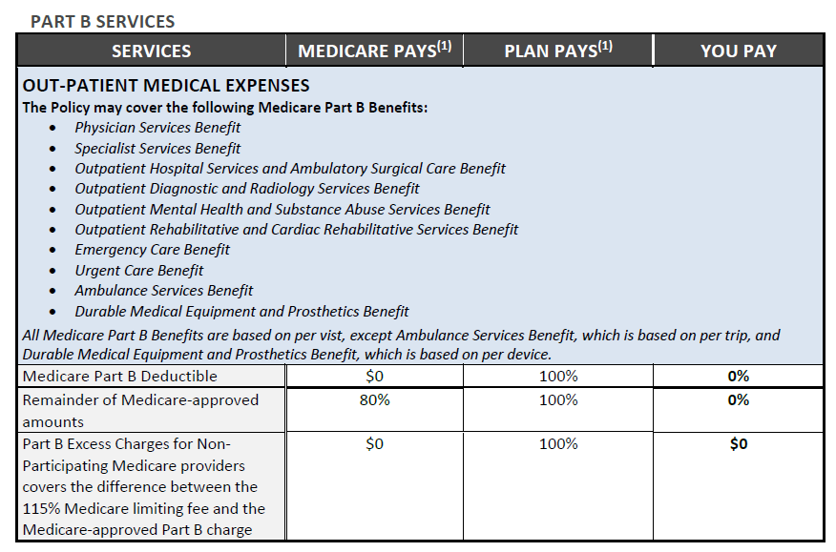
Medical Benefits

Slide 13
Medical Benefits

Slide 14
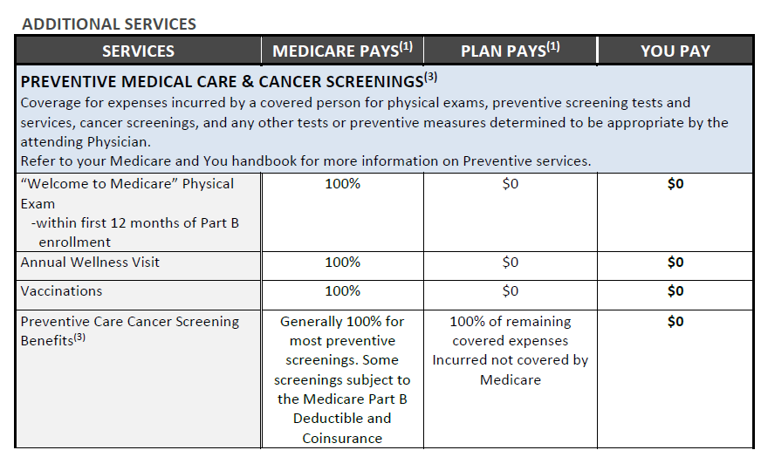
Medical Benefits

Slide 15
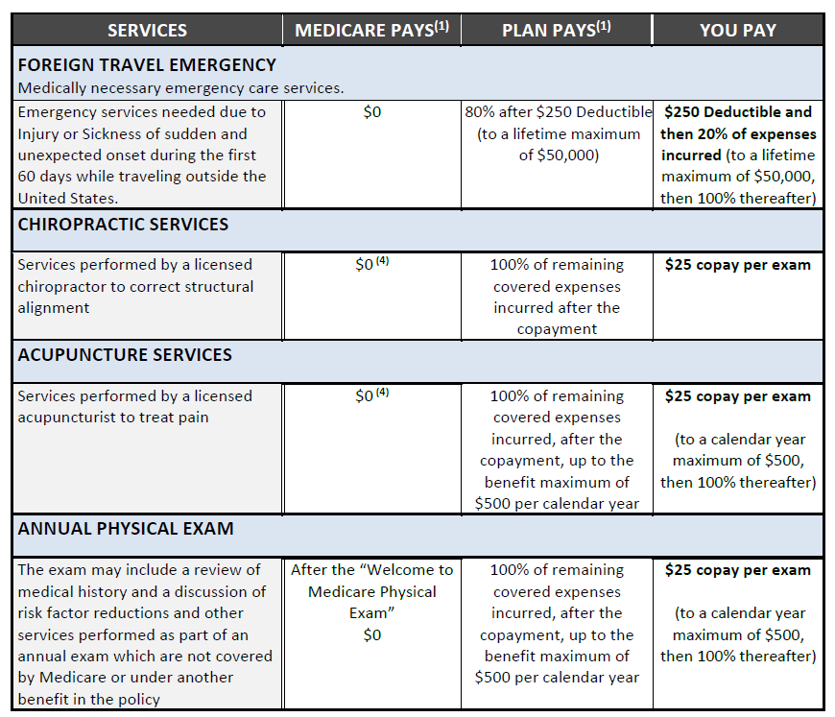
Medical Benefits

Slide 16
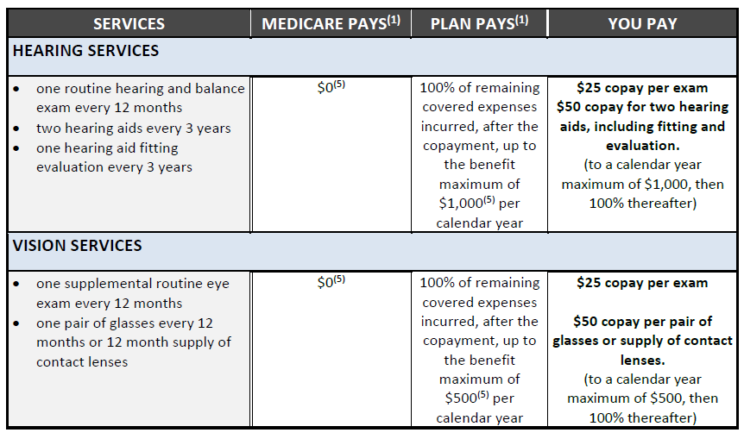
Medical Benefits

Slide 17



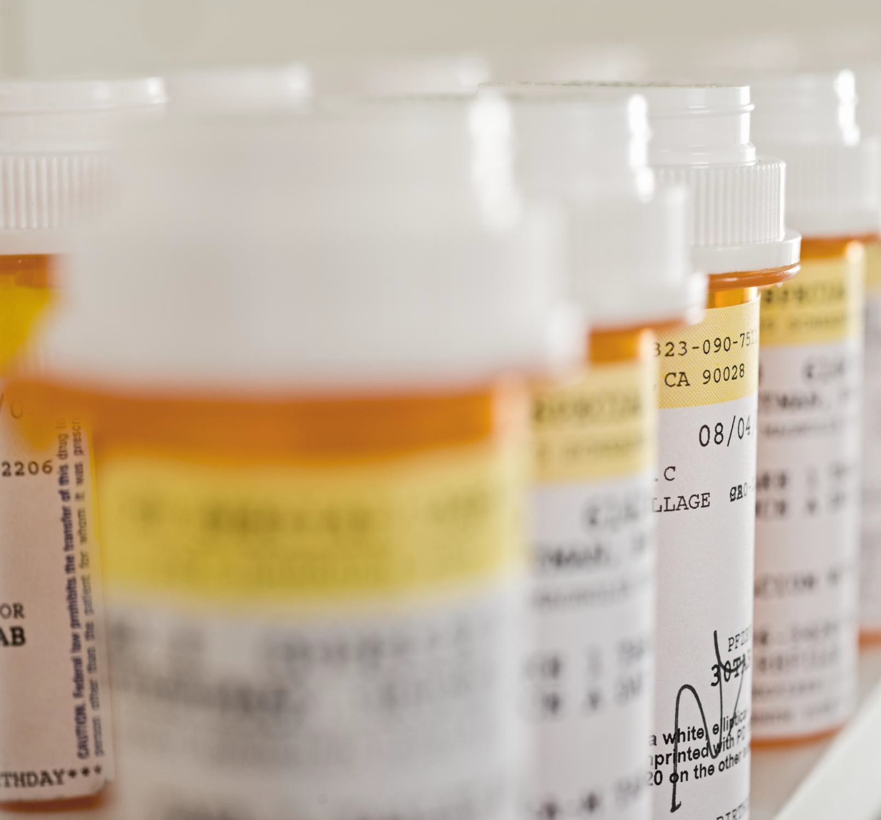
2026 Group Retiree Pharmacy Benefit Highlights
The Medicare Premier Access formulary your plan uses covers 100% of Part D drugs, so all Part D drugs you currently use will be covered.
Coverage for most Non-Part D Medications is also included.
You have access to over 68,000 major retail chain pharmacies.
All pharmacy plan offerings include:
$0 deductible
$35 maximum copay for insulin
$2,100 Out of Pocket Maximum on Part D Drug costs each plan year.

Slide 18


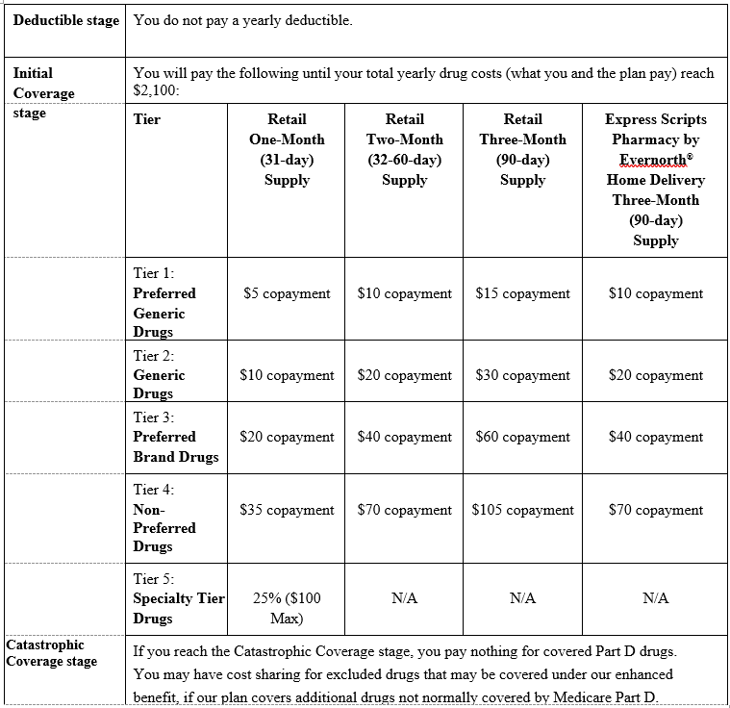
Express Scripts Part D Plan
This pharmacy plan was designed to closely match your current benefits

Slide 19
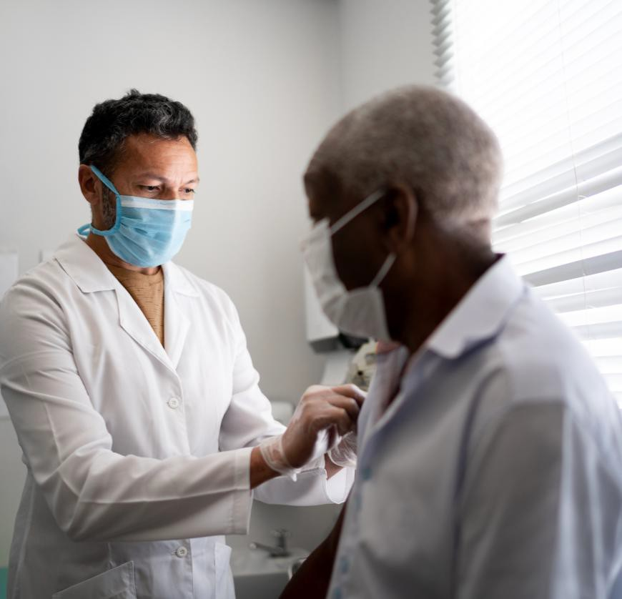
Medicare Part B - Vaccines
The following vaccines are covered under
Medicare Part B:
Hepatitis B vaccine for patients at high or intermediate risk (liver infection treatment shot)
Influenza virus vaccine (flu shot)
SARS-CoV-2 vaccine (COVID-19 vaccine)
Pneumococcal pneumonia vaccine (pneumonia shot)

Slide 20

Medicare Part D - Vaccines
The following vaccines are covered under Medicare Part D.
Shingles vaccine
RSV
Human papillomavirus (HPV)
Diphtheria and Tetanus
Measles, mumps, rubella (MMR)
Pertussis (whooping cough)

Slide 21
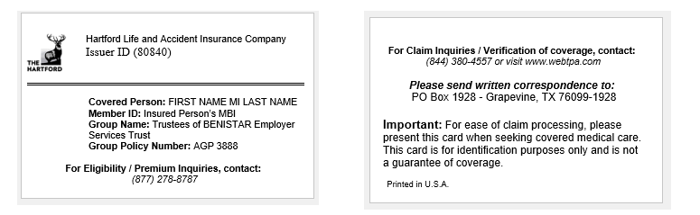

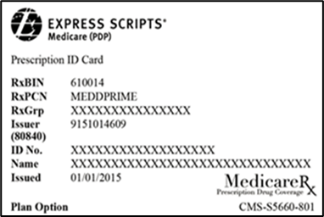
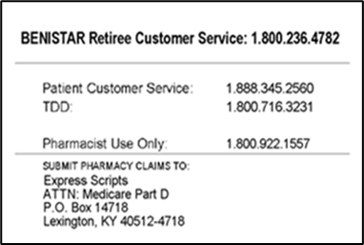
Sample ID Cards
Sample Carrier Name & Sample Medical ID Cards
Sample Carrier Name & Sample Pharmacy ID Cards

Slide 22
Next Steps and Enrollment
Automatic electronic enrollment.
If you currently are enrolled in the UHC MAPD plan Eligible retirees and spouses will be automatically enrolled in this coverage. No action is needed on your part.
Announcement letters should have already arrived to your home.
Welcome kits will be mailed by The Hartford and Express Scripts and will arrive in Early to Mid November
San Ramon USD will be hosting an in-person informational meeting at 1:00 PM on November 17th at the San Ramon USD Home Office in the Board Room at 699 Old Orchard Drive, Danville CA 94526.
If you wish to opt out of the plan or enroll in another plan offered by San Ramon USD please contact the Sand Ramon HR and benefits department.
Any questions should be directed to Benistar Administrative Services at 1-800-236-4782 or emailed to Dayna Zaks at DaynaZaks@hismi.com.

Slide 23
Frequently Asked Questions
How do I enroll in the plan?
Who do I call if I need assistance with the plan?
Who is Benistar?
Is my provider in-network?
How do I check if my medications are covered and what their copay is?
How do I know if I need a prior authorization for a medication?
How can I sign up for Mail Order?
Are Pre-Existing Conditions Covered?

Slide 24
Frequently Asked Questions
Does this plan require referrals?
Does this plan require pre-certifications?
Does this plan have a network?
What card do I use at the pharmacy and the doctor’s office?
Can I go to the same retail pharmacy?
Will my prescriptions transfer from my old plan?
What if my provider says they don’t accept this plan?
When will I receive my welcome kit and IDs?

Slide 25
Open Q&A
Announcement letters and welcome kits will be arriving in the next few weeks. Please keep an eye on the mail.
For live questions today:
Type questions in the chat.
Text questions to 248-701-9218
Email questions to DaynaZaks@hismi.com
Personal questions or any other questions that come up in the future please contact Benistar Administrative Services at 1-800-236-4782 or email Dayna Zaks at DaynaZaks@hismi.com.

